Slide 1


Single Cell Perturbation Analysis With Geneformer
© ThinkBio.Ai All Right Reserved

Slide 2

Agenda
Gene Embeddings and Insilico Perturbation
VCC and Perturbation
Application of Geneformer's ISP in VCC
Results

Slide 3
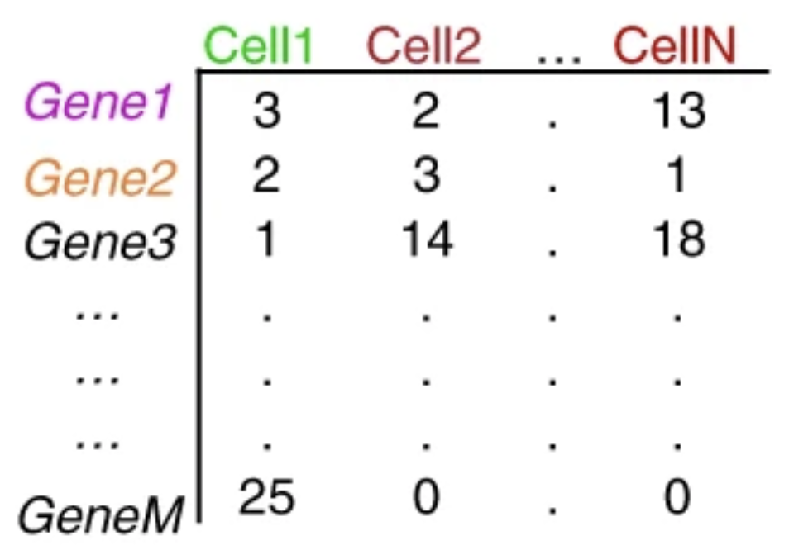
Gene Embeddings
Geneformer the foundation model
Rank value encodings
HVGs
What are gene embeddings
KEYS
GENEFORMER Encoder
TP53
EGFR
BRCA1
MYC
KRAS
CDK1
…
BCL2
PTEN
ATM
MAPK1
4096 HVGs
Cell X Gene matrix
TP53:
[ 0.12, -0.45, 1.03, ..., -0.18, 0.77 ] ← 768 dim
EGFR:
[-0.34, 0.91, 0.22, ..., 1.02, -0.44 ]
BRCA1
[ 0.88, 0.14, -0.67, ..., -0.09, 0.51 ]
Rank value Encodings
Cell Embedding
[-0.34, 0.91, 0.22, ..., -0.89, 1.14 ] - 768 dim

Slide 4


Insilico Perturbation Using Geneformer
Geneformer the foundation model
Rank value encodings
HVGs
What are gene embeddings
KEYS
KRAS perturbed cell’s embedding
GENEFORMER Encoder
TP53
EGFR
BRCA1
MYC
KRAS
CDK1
…
BCL2
PTEN
ATM
MAPK1
4096 HVGs
Cell X Gene matrix
TP53
EGFR
BRCA1
MYC
CDK1
…
BCL2
PTEN
ATM
MAPK1
4096 HVGs
TP53:
[ 0.12, -0.45, 1.03, ..., -0.18, 0.77 ] ← 768 dim
EGFR:
[-0.34, 0.91, 0.22, ..., 1.02, -0.44 ]
BRCA1
[ 0.88, 0.14, -0.67, ..., -0.09, 0.51 ]
Rank value Encodings
Cell Embedding
[-0.34, 0.91, 0.22, ..., -0.89, 1.14 ] - 768 dim

Slide 5
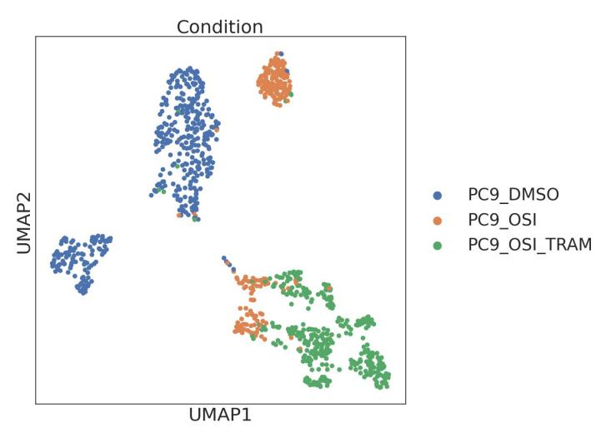
In
GENEFORMER Encoder

Slide 6
VCC and Perturbation

Slide 7
Limitations of using Genformer
Cell x gene
GENEFORMER Encoder
GENEFORMER
Decoder
TP53
EGFR
BRCA1
MYC
KRAS
CDK1
…
BCL2
PTEN
ATM
MAPK1
TP53
EGFR
BRCA1
MYC
KRAS
CDK1
…
BCL2
PTEN
ATM
MAPK1
18080 genes per cell
4096 genes per cell
4096 genes per cell
Cell X Gene
Rank value Encodings
Rank value Encodings

Slide 8
Design of the used model
Cell input vector (4096)
↓
Dense + LayerNorm + GELU
↓
1024
↓
Dense + LayerNorm + GELU
↓
2048
↓
Dense + LayerNorm + GELU
↓
4096
↓
Dense + LayerNorm + GELU
↓
8192
↓
Output Layer
↓
18,080 gene expression values

Slide 9
In

Slide 10
In

Slide 11
In

Slide 12
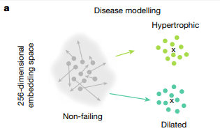
INSILICO PERTURBATION AT CELL EMBEDDING – REPRESENTATION
Clustering nature of cell embeddings
knock out not only a single gene but also multiple genes at a time.
Cosine Shift concept
KEYS

Slide 13
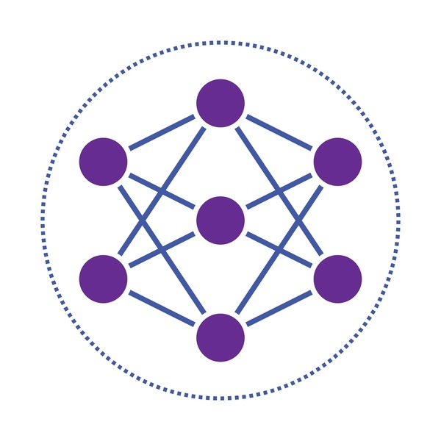
VCC AND PERTURBATION
TRAINING
List of genes to be perturbed
g1,
g2,
g3,
..
..
..
..
g150
Ground truth provided by VCC
Perturbed gene | No of cells
g1 | 4000
g2 | 3800
g3 | 3750
g150 | 15
Unperturbed cells
+
38 k cells
VALIDATION
g1,
g2,
g3,
..
..
g50
+
Predict expression
TEST
g1,
g2,
g3,
..
..
g100
+
Predict expression

Slide 14
3. GENEFORMER FOR VCC
Cell x gene
GENEFORMER Encoder
GENEFORMER
Decoder
TP53
EGFR
BRCA1
MYC
KRAS
CDK1
…
BCL2
PTEN
ATM
MAPK1
TP53
EGFR
BRCA1
MYC
KRAS
CDK1
…
BCL2
PTEN
ATM
MAPK1
18080 genes per cell
4096 genes per cell
4096 genes per cell
Cell X Gene
Rank value Encodings
Rank value Encodings

Slide 15
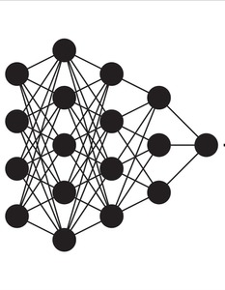
3. GENEFORMER FOR VCC
3. 1. Limitations of using Geneformer Decoder
Cell x gene
GENEFORMER Encoder
TP53
EGFR
BRCA1
MYC
KRAS
CDK1
…
BCL2
PTEN
ATM
MAPK1
18080 genes per cell
4096 genes per cell
Cell X Gene
Rank value Encodings

Slide 16
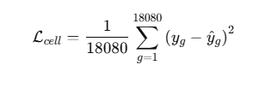
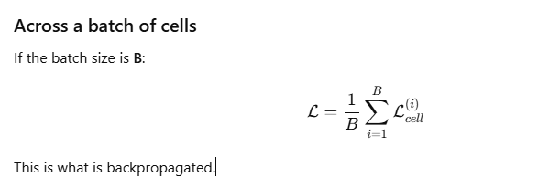
3. 2. Design for the Model
MSE LOSS PER CELL
Cell input vector (4096)
↓
Dense + LayerNorm + GELU
↓
1024
↓
Dense + LayerNorm + GELU
↓
2048
↓
Dense + LayerNorm + GELU
↓
4096
↓
Dense + LayerNorm + GELU
↓
8192
↓
Output Layer
↓
18,080 gene expression values
MSE LOSS FOR THE ENTIRE BATCH

